Slide 1



Unit 7: Tourism
Lesson 7C: LISTENING

Slide 2
CHECK YOUR TICKET!
Listening
I can understand and use emphatic stress.
7C
Student Book – page 85

Slide 3
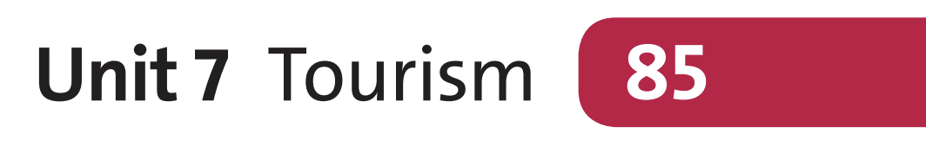
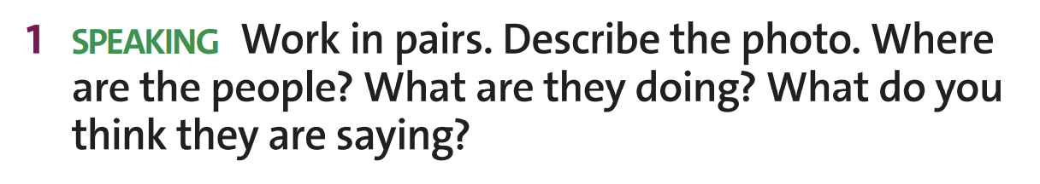
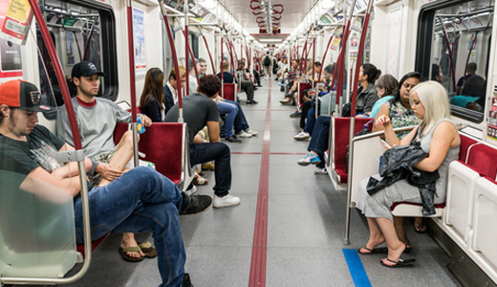

Listening
*Suggested answer:
→ They’re on a train.
→ The passengers are sitting in their seats and waiting for their arrival.
→ Some people are chatting with their friends. Some are using smartphones, others are taking a nap.
→ Perhaps people at the back are talking about daily jobs.
Answer
www.phuongnam.edu.vn
Notes:
Chưa có hoạt động warm-up

Slide 4
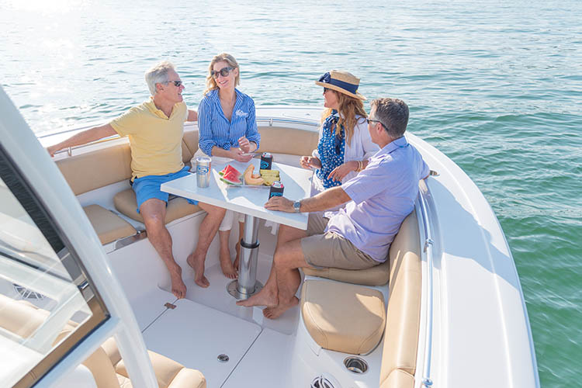
Listening
**Suggested answers:
→ They’re on a yacht.
→ The passengers are sitting at the front deck and having a snack.
→ They look happy and relaxed.
→ Perhaps they are talking about what they can do on their holiday.
Answer
www.phuongnam.edu.vn
Notes:
Chưa có hoạt động warm-up

Slide 5
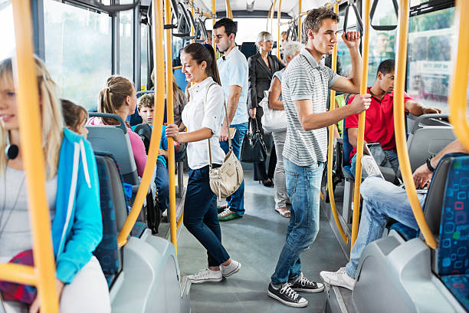
Listening
**Suggested answers:
→ They’re on a bus.
→ Some people are sitting while others are standing.
→ They look busy and tired.
→ Perhaps they are discussing what they will do afterwork.
Answer
www.phuongnam.edu.vn
Notes:
Chưa có hoạt động warm-up

Slide 6
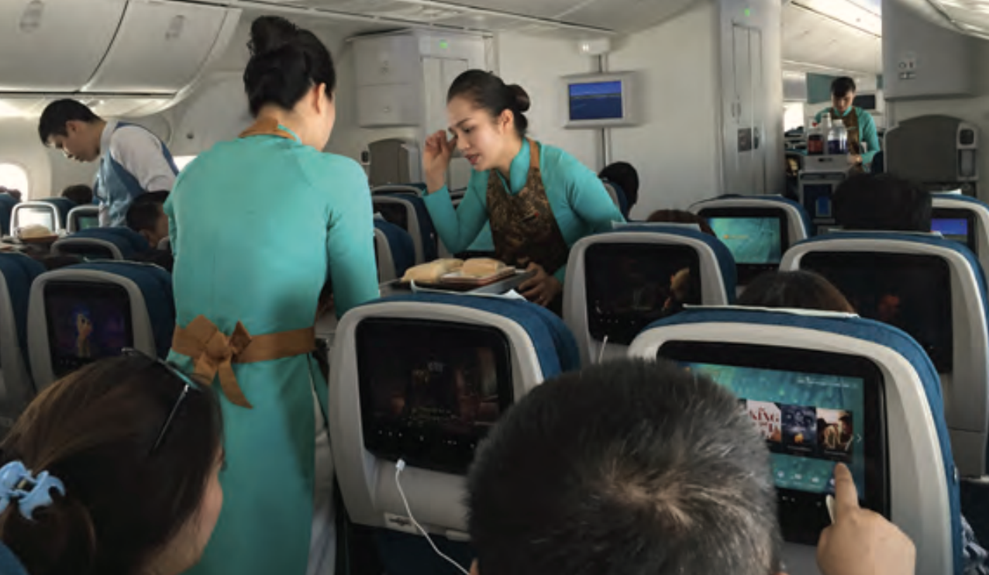
Listening
→ They’re on a plane.
→ The passengers are sitting in their seats and taking meals from the flight attendant.
→ She is offering them their meals.
→ They are saying what kind of meal they want and thanking the flight attendant.
→ The people at the front of the photo are talking about what they can see on the screen.
Answer
www.phuongnam.edu.vn
Notes:
Chưa có hoạt động warm-up

Slide 7
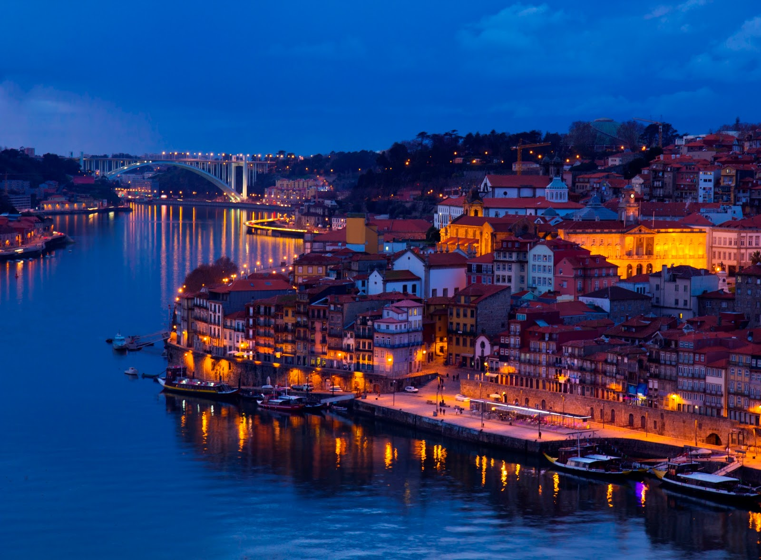
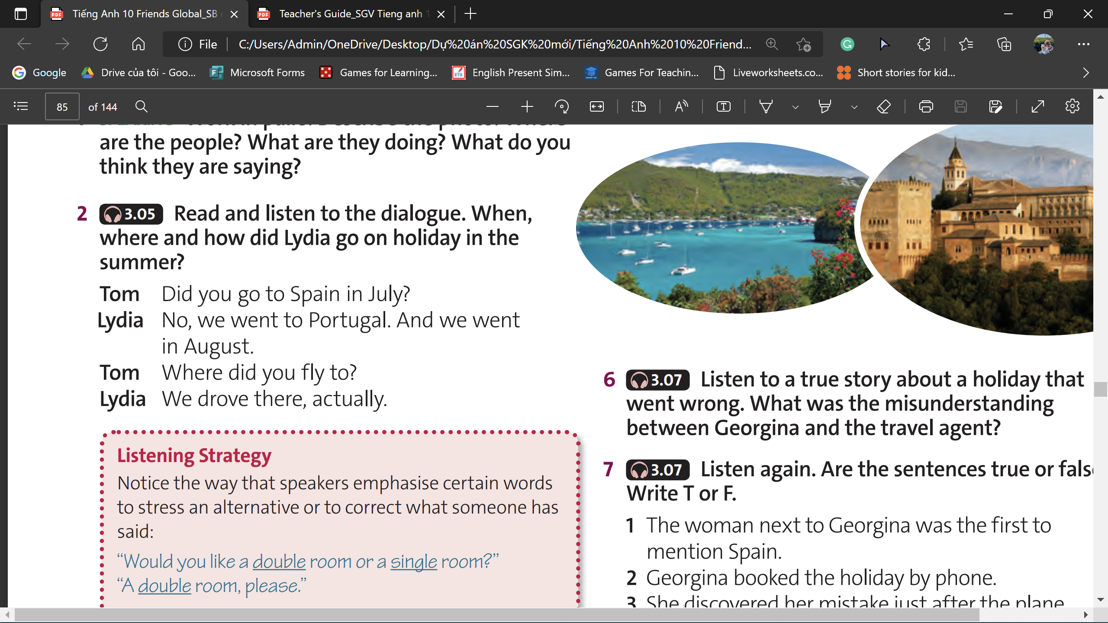

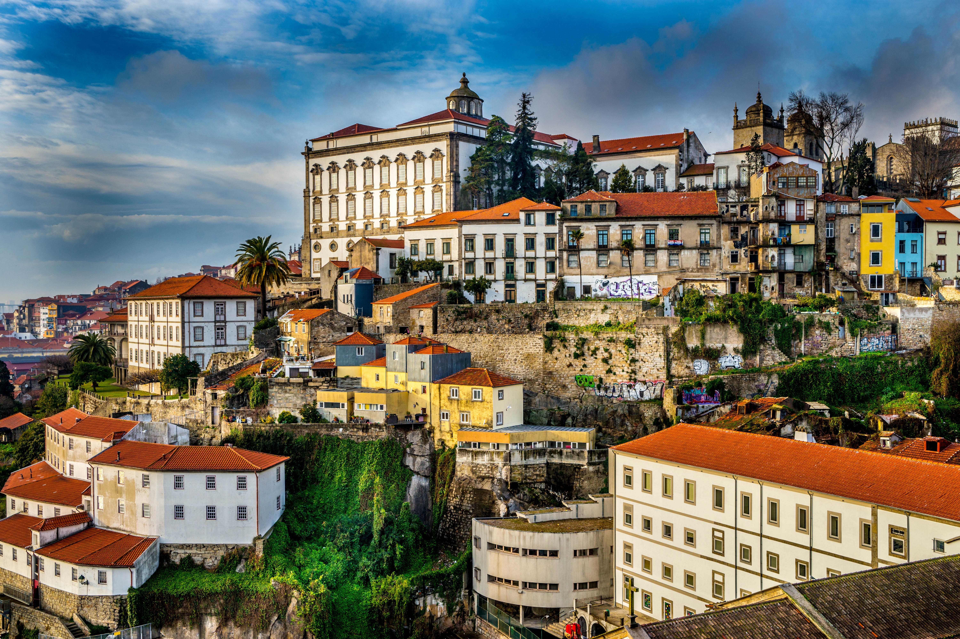
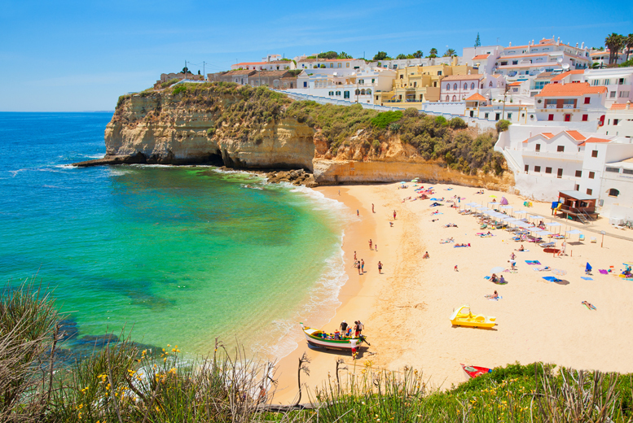
Listening
→ Lydia went to Portugal in August.
She went by car.
www.phuongnam.edu.vn

Slide 8
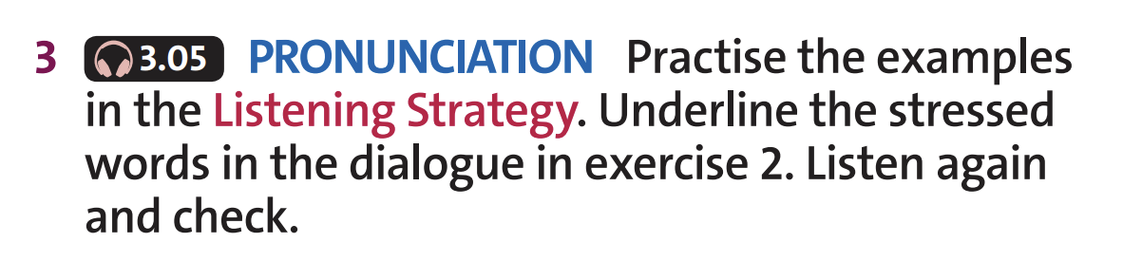
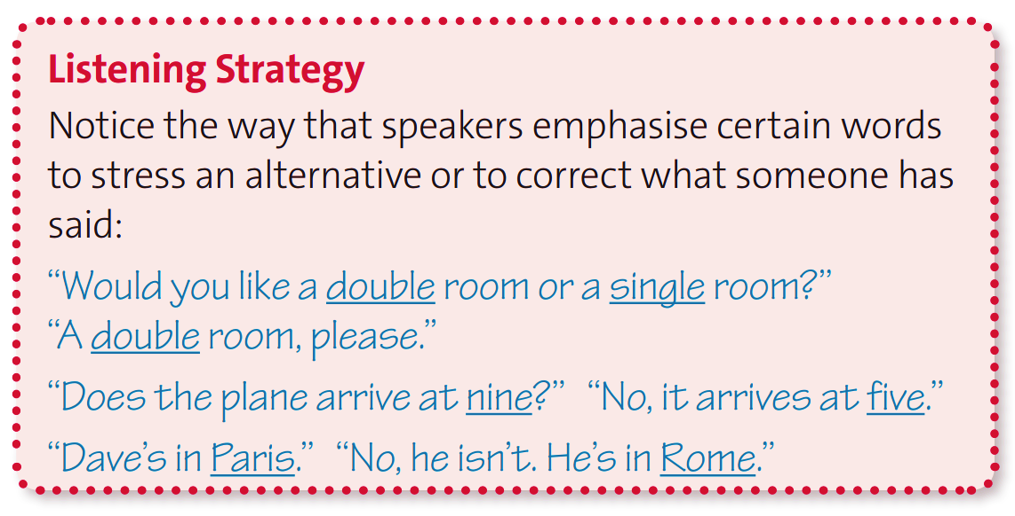
Listening
The
Stressed
Words
www.phuongnam.edu.vn

Slide 9
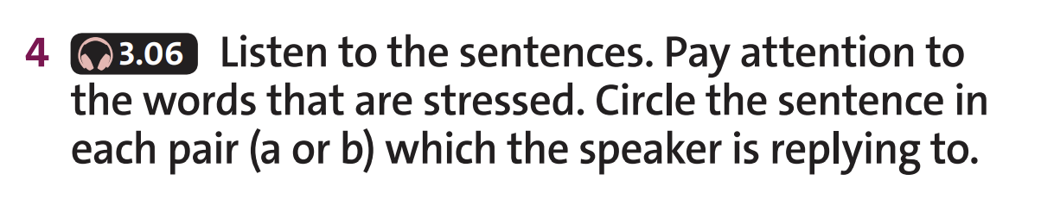
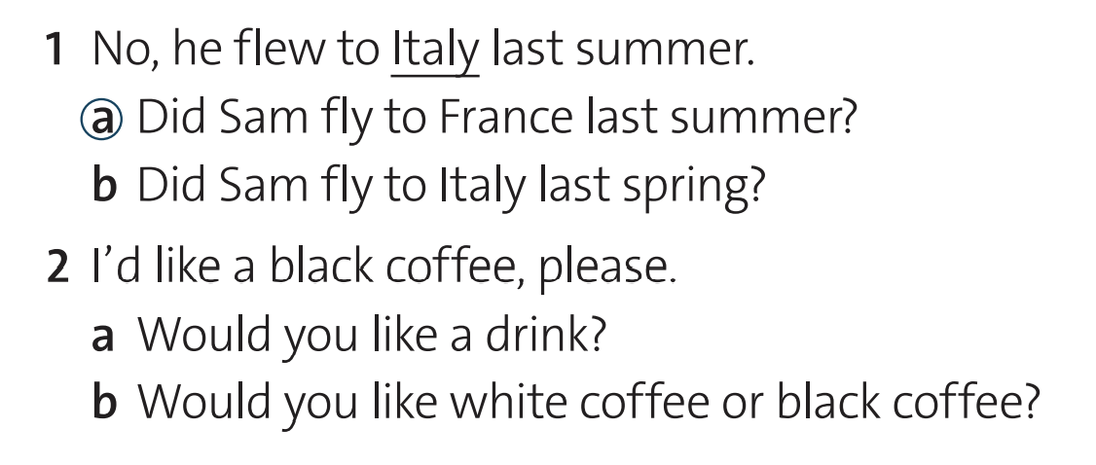
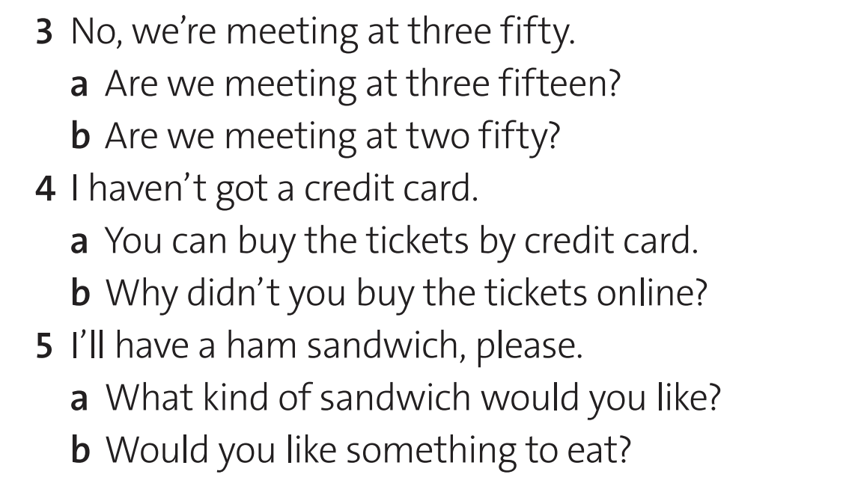
Listening
Stressed words
2
black
3
meeting
fifty
4
got
5
ham
www.phuongnam.edu.vn

Slide 10
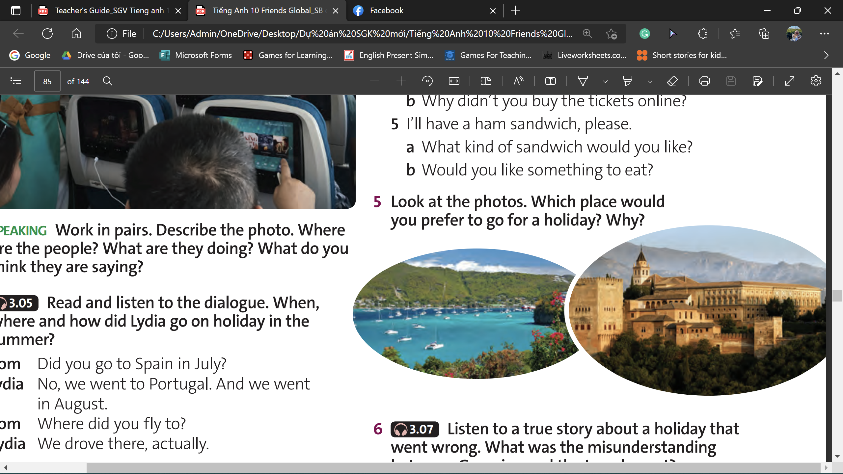

Speaking
I prefer going to the Admiralty Bay because I like its endless scenic beauty.
I prefer going to the Alhambra Palace because I like the historic architecture there.
Hmmm …
Admiralty Bay on the island of Bequia – Grenada – Spain
Alhambra Palace – The city of Grenada – Spain
Can you guess the places in both pictures ?
www.phuongnam.edu.vn

Slide 11
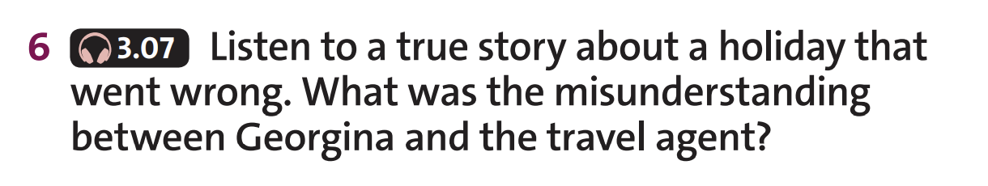
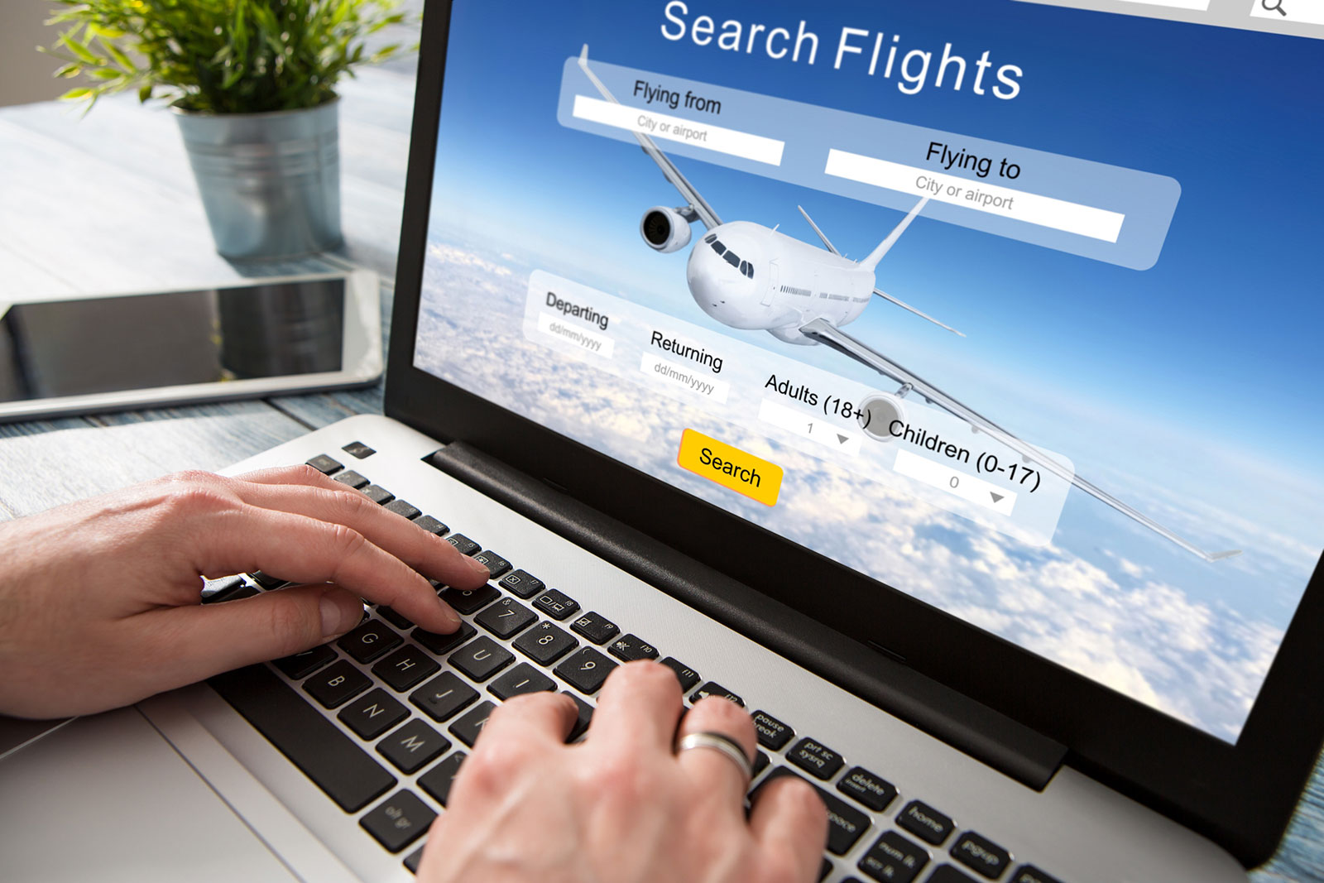
Listening
Can you guess what the misunderstanding was?
How do you think it happened?
Suggested
Answer
Detailed
Answer
Georgina booked a plane ticket to a place on her holiday, but the travel agent might misunderstand and thought of another destination.
Georgina wanted to go to Granada in Spain, but the travel agent thought she said Grenada in the Caribbean.
www.phuongnam.edu.vn

Slide 12
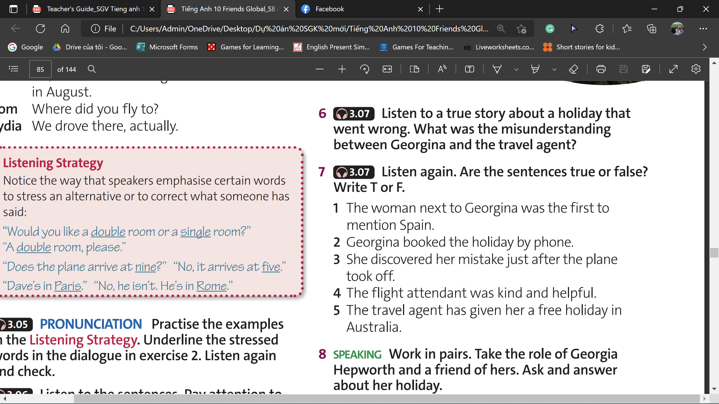
Listening
1
False
2
True
3
False
4
True
5
False
→ Work in pairs and correct the False sentences.
www.phuongnam.edu.vn

Slide 13
Listening
Correct the False sentences
1
False
→ Georgina was the first to mention Spain.
3
False
→ Georgina discovered the mistake after the plane had taken off for 2 hours.
5
False
→ The travel agent has given her a free holiday in Austria, not Australia.
www.phuongnam.edu.vn
Notes:
Thầy check đáp án phần correct giúp em nhé tại vì nó không có đáp án sẵn.

Slide 14
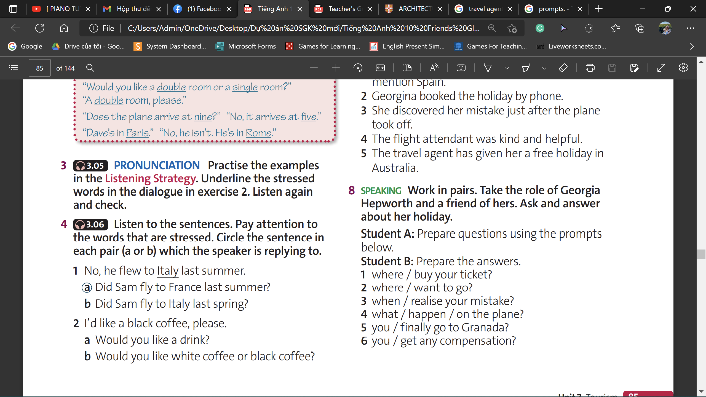
Speaking
Rewrite the questions
1. Where did you buy your ticket?
2. Where did you want to go?
3. When did you realise your mistake?
4. What happened on the plane?
5. Did you finally go to Granada?
6. Did you get any compensation?
www.phuongnam.edu.vn

Slide 15

Let’s Role-play !
Hi Georgina!
How was your holiday?
It was fascinated!
You won’t believe what I’ve been through.
Georgina’s friend
Georgina
www.phuongnam.edu.vn
Notes:
Thầy check lại tất cả đáp án ph giúp em, em không biết ghi đúng ngữ pháp không nữa ☺

Slide 16
Let’s Role-play !
1
Where did you buy your ticket?
I called a travel agent to book the flight.
Georgina’s friend
Georgina
www.phuongnam.edu.vn

Slide 17
Let’s Role-play !
2
Where did you want to go?
I was very interested in Spain. So I spent my holiday there.
Georgina’s friend
Georgina
www.phuongnam.edu.vn

Slide 18
Let’s Role-play !
3
When did you realise your mistake?
I found out I was in the wrong flight after 2 hours since the plane took off.
Georgina’s friend
Georgina
www.phuongnam.edu.vn

Slide 19
Let’s Role-play !
4
Well, after I talked to the flight attendant, she allowed me to sit in first-class seat.
What happened on the plane?
Georgina’s friend
Georgina
www.phuongnam.edu.vn

Slide 20
Let’s Role-play !
5
Yes, when the plane finally arrived in the Caribbean, the airline put me in a hotel for the night and then, on the following day, they flew me back to Granada in Spain.
Did you finally go to Granada?
Georgina’s friend
Georgina
www.phuongnam.edu.vn

Slide 21
Let’s Role-play !
6
After that, the travel agent apologized for the misunderstanding and even gave me a free holiday in Austria.
It was fun!
Did you get any compensation?
Georgina’s friend
Georgina
www.phuongnam.edu.vn

Slide 22
Homework
1. Review the lesson.
2. Do exercises in Workbook.
3. Prepare U7-D (P.86)

Slide 23

www.phuongnam.edu.vn

Slide 24



Thank you!
CTCP ĐẦU TƯ VÀ PHÁT TRIỂN GIÁO DỤC PHƯƠNG NAM

